Slide 1



Fatigue Characterization of Asphalt Binders with the Linear Amplitude Sweep (LAS)
Cassie Hintz, Raul Velasquez, Hassan Tabatabaee, Hussain Bahia
Updated in 03/19/2019

Slide 2
Content
Part 1: Binder Fatigue Testing
Part 2: LAS: Theoretical Base
Part 3: Performing the LAS test
  Anton Paar Rheometers
  TA Rheometers
  Bohlin Rheometers
Part 4: Analysis of LAS results

Slide 3
Binder fatigue testing
PART 1:

Slide 4
Superpave Bitumen Tests
Related to Performance!
Climate -- PG HT-LT
Traffic Speed – DSR
Traffic Volume – PG shift
Traffic loading – NA
Pavement Structure – NA
Assumption:
Bitumen in Linear VE
range
DSR
DT
Dynamic Shear
Rheometer
Direct
Tension Test
RV
BBR
Rotational
Viscometer
Bending Beam Rheometer
Notes:
4

Slide 5
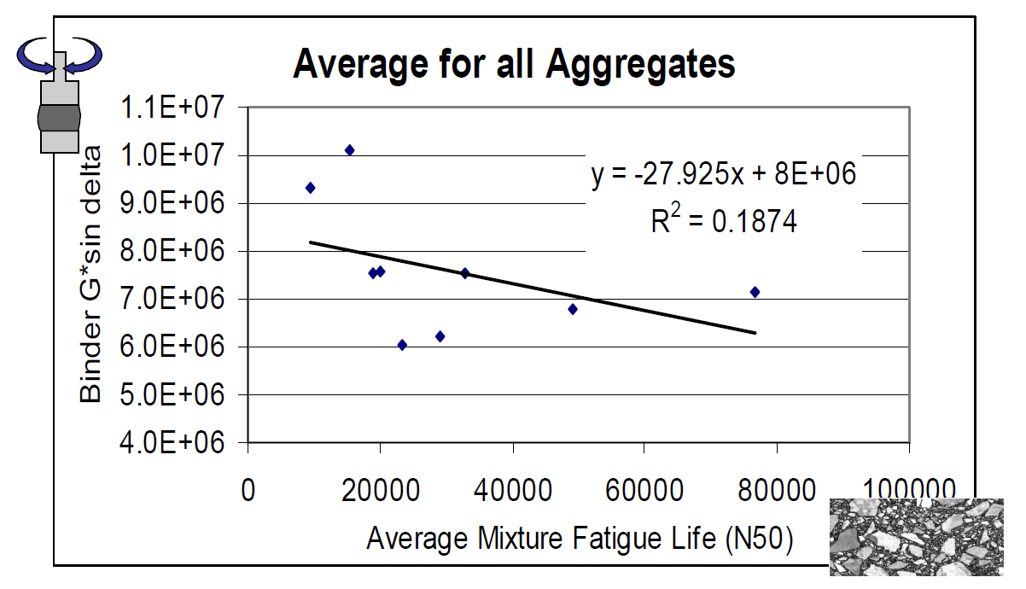
Binder Fatigue: Superpave Specification (|G*|·sinδ)
Data from NCHRP 9-10

Slide 6
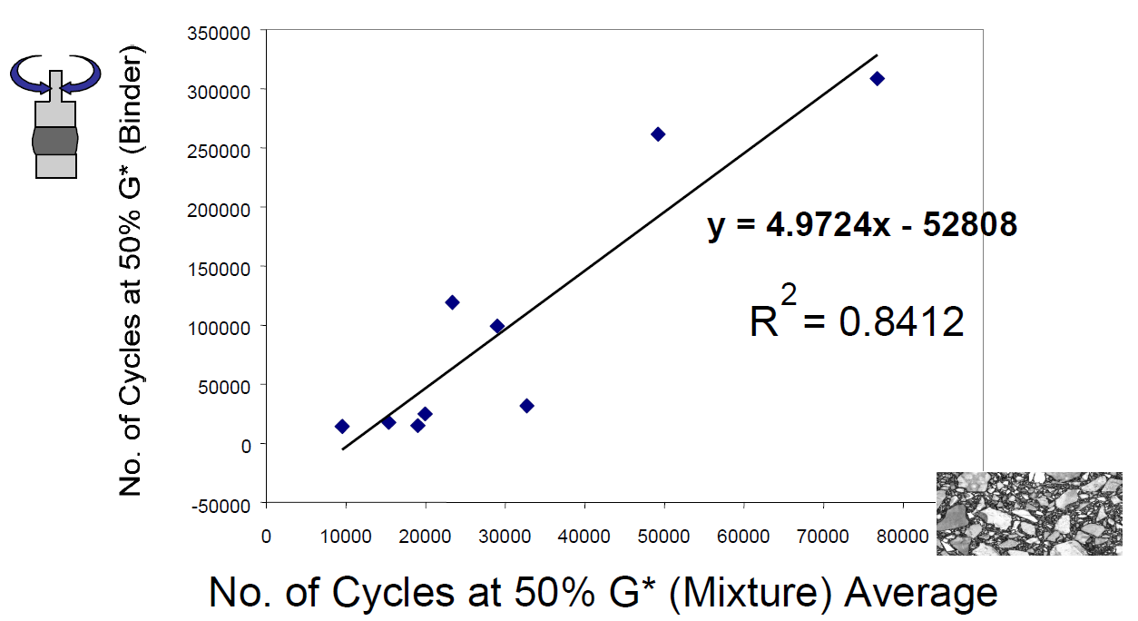
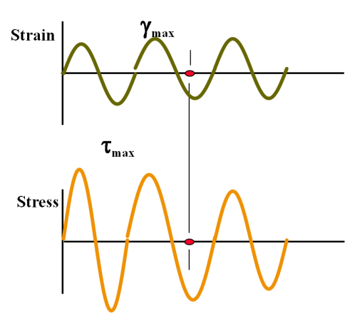
Binder Fatigue: Time Sweep (NCHRP 9-10)

Slide 7
Background – Asphalt Mixture Fatigue
Asphalt mixture fatigue characterization relies on following fatigue law:
  Number of Cycles to Failure = A × (Applied Load)^{B}
MEPDG Model:
stiffness / temperature
traffic
structure
where: h_{ac} = Total thickness of the asphalt layers

Slide 8
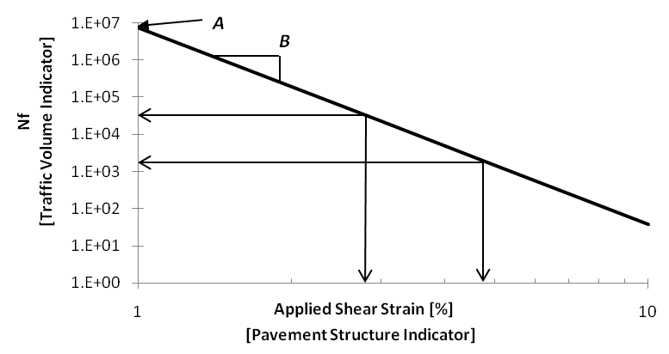
Background – Asphalt Fatigue

Slide 9
Background – VECD
Viscoelastic Continuum Damage (VECD) analysis has been used for asphalt mixtures since the late 1980’s.
Relies on constitutive modeling to determine the deviation of damaged test results from undamaged properties.
Deviation from initial undamaged properties with respect to number of cycles used to calculate damage.
Characteristic plot used to back-calculate fatigue performance under different testing conditions.

Slide 10
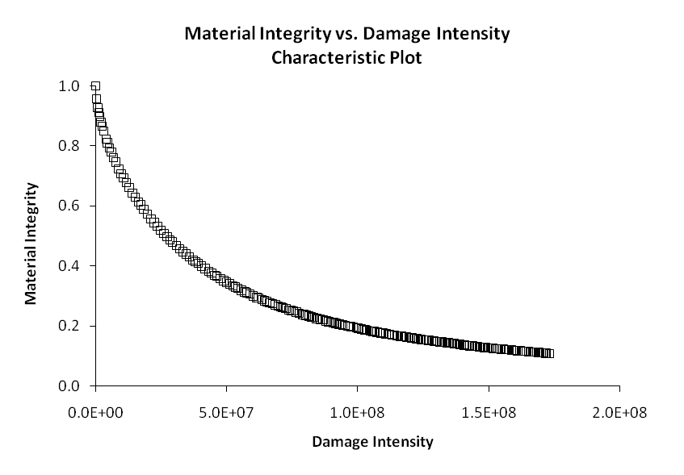
Background – VECD

Slide 11
Background – Summary
Asphalt concrete has been shown to have a well-defined relationship between loading input and fatigue life.
VECD analysis can be an effective tool to determine damage characteristics.
Conventional binder fatigue procedure (time sweep) is problematic.
Binder fatigue testing needs an efficient procedure that can do more than rank relative performance for a single condition.

Slide 12
Linear amplitude sweep: theoretical base
AASHTO TP101-12
PART 2:

Slide 13
NewTest Method
Linear Amplitude Sweep
  Employs the DSR and standard geometry
  Systematically increases applied load to accelerate damage
  Strain-controlled to avoid accumulated deformation
  Use of VECD allows for calculation of fatigue life at any strain level

Slide 14
New Test Method
Frequency Sweep
+

Slide 15
Background – Asphalt Fatigue

Slide 16
Fatigue Law Parameter “B”
  B = -2α
  α obtained from frequency sweep
  α can be calculated using the slope of log-log G’(ω) plot
    where G’(ω)=|G*|·cos δ(ω)
  α = 1 + 1/m
    where m is slope of the log-log G’(ω) plot

Slide 17

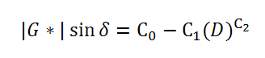
Fatigue Law Parameter “A”
Where
  D_{f} = (0.35)(C₀ / C₁)^(1 / C₂)
    Damage at failure: Failure corresponds to a 35% reduction in G*·sinδ
  f = Loading frequency (10 Hz).
  k = 1 + (1 – C₂)α
  I_{D} = undamaged complex modulus
C₁ and C₂ come from curve fit:
  Where D = damage

Slide 18
Damage Curve

Slide 19
Parameters C₁ and C₂
Model can be linearized to determine curve coefficients:
Y = µ + β·x
  C₀ is average |G*|·sinδ from the 0.1% strain step
  log(C₁) is intercept and C₂ is slope of
  log(C₀ - |G*|·sinδ) versus log(D(t))
  **IGNORE DATA CORRESPONDING TO D(t) less than 100

Slide 20
Linearized Damage Curve

Slide 21
Linear amplitude sweep: theoretical base
AASHTO TP101-14
Updated part
New Standard
P21-26
PART 2:

Slide 22
Fatigue Law Parameter “B”
  B = -2α
  α obtained from frequency sweep
  α can be calculated using the slope of log-log G’(ω) plot
    where G’(ω)=|G*|·cos δ(ω)
  α = 1/m
    where m is slope of the log-log G’(ω) plot

Slide 23



Fatigue Law Parameter “A”
Where
  D_{f} = (C₀ – C at Peak Stress/C₁)^(1 /C₂)
    Damage at failure: Failure corresponds to the reduction in initial G’(ω) at the peak shear stress
  f = Loading frequency (10 Hz)
  k = 1 + (1 – C₂)α
C₁ and C₂ come from curve fit:
  Where D = damage
  C(t)= , which is |G*| at time, t divided by the initial “undamaged”
  value of |G*|
$$A=\frac{f{(D_{f})}^{k}}{k{(πC_{1}C_{2})}^{α}}$$
$$C(t)=C_{0}−C_{1}D^{C_{2}}$$
$$\frac{\left|G^{∗}\right|(t)}{{\left|G^{∗}\right|}_{initial}}$$

Slide 24
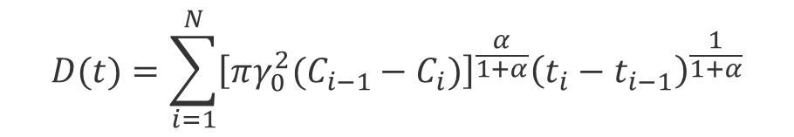

Damage Curve
$$C(t)=C_{0}−C_{1}D^{C_{2}}$$
$$D(t)=\sum_{i=1}^{N}{{\left[πγ_{0}^{2}(C_{i−1}−C_{i})\right]}^{\frac{α}{1+α}}{\left(t_{i}−t_{i−1}\right)}^{\frac{1}{1+α}}}$$

Slide 25

Parameters C₁ and C₂
Model can be linearized to determine curve coefficients:
$$C(t)=C_{0}−C_{1}D^{C_{2}}$$
$$\log\left(C_{0}−C\left(t\right)\right)=\log{C_{1}}+C_{2}log⁡(D\left(t\right))$$
Y = µ + β·x
  C₀ =1, the initial value of C
  log(C₁) is intercept and C₂ is slope of
  log(C₀ – C (t )) versus log(D (t ))
  **IGNORE DATA CORRESPONDING TO D(t) less than 10

Slide 26
Linearized Damage Curve
$$\log\left(C_{0}−C\left(t\right)\right)=\log{C_{1}}+C_{2}log⁡(D\left(t\right))$$

Slide 27
Summary
The LAS test is a DSR procedure consisting of a frequency sweep and strain amplitude sweep
Goal: derive fatigue law
Parameters “A” and “B” are
binder properties
  “A” from amplitude sweep
    Higher A increases fatigue life
  “B” from frequency sweep
    Higher magnitude of B decreases fatigue life (at a constant A)
Traffic
Structure

Slide 28
Performing the LAS Test:
(a) Anton-paar rheometers
PART 3:

Slide 29
Anton-Paar Rheometers
The test has been successfully tested on the following Anton-Paar Rheometers:
  MCR 300 (Smartpave)
  MCR 301
Direct Strain Oscillation (DSO) module recommended but not required

Slide 30
Anton-Paar Rheometers
 | A | % Difference
With DSO | 8.04E+06
Without DSO | 8.75E+06 | 8.47%

Slide 31
Anton-Paar Rheometers
Video

Slide 32
Performing the LAS Test:
(b) TA rheometers
PART 3:

Slide 33
TA Rheometers
Procedure can be run as specified in AR2000 EX
AR2000 at UW does not have capability to conduct procedure exactly as specified but results are not substantially affected
  Cannot allow for 100 cycles of loading per strain exactly (typically includes 120-140 cycles per strain step)
  Cannot generate one point per second (able to obtain approximately one point every three seconds)

Slide 34
TA Rheometers
Video

Slide 35
Performing the LAS Test:
(b) Bohlin rheometers
PART 3:

Slide 36
Bohlin
Unable to successfully conduct LAS test in UW’s Bohlin C VOR-200 rheometer
  DSR stops oscillating between strain steps
  Malvern support stated their Kinexus rheometers are capable of running procedure
  Contact with Malvern support revealed there was no solution
    UW’s rheometer requires several seconds to process data between each strain step
    Faster computer will reduce “rest” between strain steps but will not eliminate the problem

Slide 37
Analysis of LAS results
PART 4:

Slide 38
Analysis of LAS Results
Analysis is easily carried out using prepared MS Excel spreadsheets

Slide 39
Analysis of LAS Results
Video

Slide 40
Summary
Linear Amplitude Sweep is being proposed to address concerns over current specification
  Efficient and practical, uses existing equipment and testing geometry
VECD analysis can be employed to account for traffic and pavement structure

Slide 41

Thank You!
Questions?
UWMARC.org
Notes:
41

